Slide 1
Edward Bennett FM014385 Password Manager

Slide 2
What is the purpose?
It is inconvenient and difficult to remember different passwords for different accounts – leads to people reusing a simple password
This creates inherent risks to security for their accounts and data
Simple, easy to remember passwords are vulnerable to brute force and dictionary attacks
Any account with a reused password is at risk of being compromised due to leaks – many accounts tied to an email with weak password

Slide 3
What is the purpose?
The goal of this project is to provide a web application that both creates and stores strong passwords for users to both increase security and reduce hassle
Stronger passwords will be longer, random, include wider ranges of characters, and will not be reused

Slide 4
Implementation
This project will be created as a web application using the MERN software stack
I am using TypeScript to produce this project, making use of the popular NestJS framework and the Forge cryptographic library

Slide 5
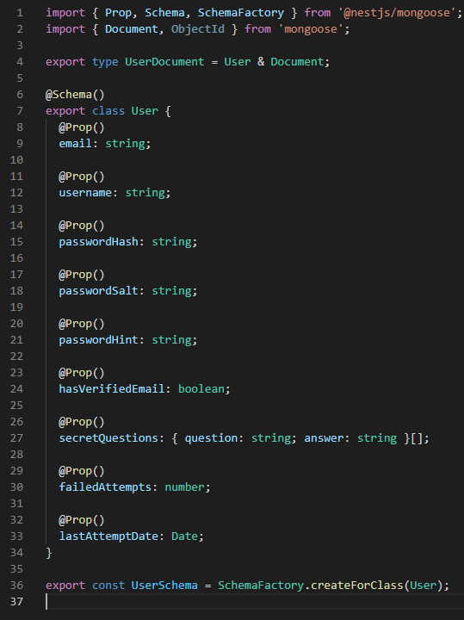
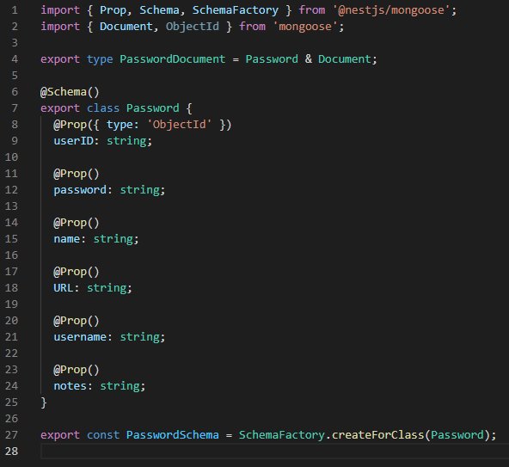
Schemas
User and password are different document types used in the database both of which have corresponding DTOs

Slide 6
Get method
I have created operational functions and endpoints to return a list of users
It is possible to request all users or one user identified via an ID
It is possible to request all passwords in the database, all passwords belonging to one user identified by ID, or one password identified by a password ID
Once user validation and authentication has been implemented it will not be possible for a user to obtain other user’s details or passwords

Slide 7
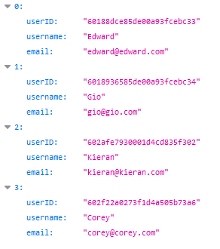

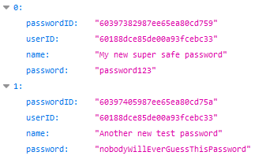

Get method
Getting all of the users in the database
Using the endpoint corresponding to localhost:3000/api/app/users
Getting all of the passwords for one user
Using the endpoint corresponding to localhost:3000/api/app/passwords/60188dce85de00a93fcebc33

Slide 8
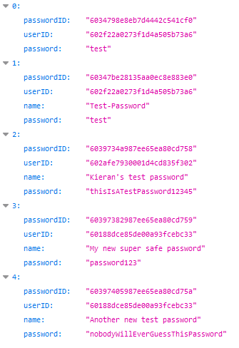
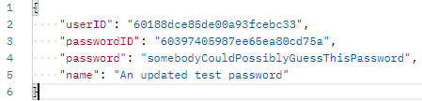
CRUD operations
I have also created operational functions and endpoints for creating, updating, and deleting users and passwords
On the left is a list of all passwords, on the right is a patch request to the endpoint localhost:3000/api/app/passwords/60397405987ee65ea80cd75a

Slide 9
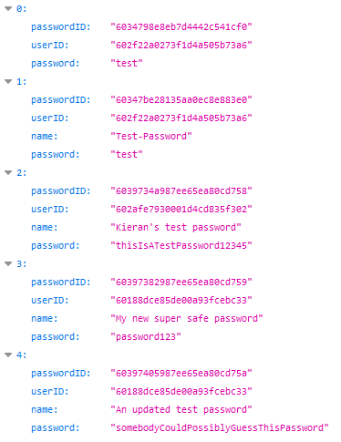
CRUD operations
This is a list of all passwords after making the patch request showing the password has been updated

Slide 10
Thank you for listening
If you have any questions I would be happy to answer them
FM014385@student.reading.ac.uk

